Slide 1

2020 Fall Online Chinese Culture Program
2020 fall virtual Chinese culture program is organized by the Chinese Cultural Center. It offers different themed cultural program featuring music, handcrafts, calligraphy, Chinese chess and Chinese history.
This daily enrichment cultural program will have a live 60 minute presentation via our virtual platform.
Register and Cost
Program will start in the week of September 14.
Space is limited. Register now.
Price :$120 per class for 10 weeks
For any inquiry, please contact us at cccsdsu@gmail.com. All rights for revisions reserved by Chinese Cultural Center.

Slide 2

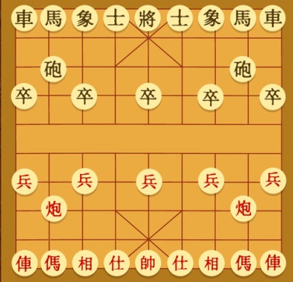
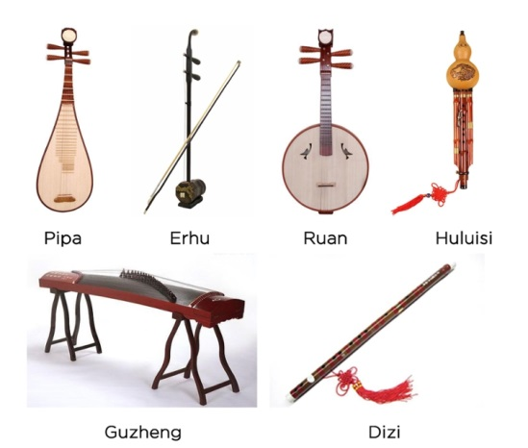
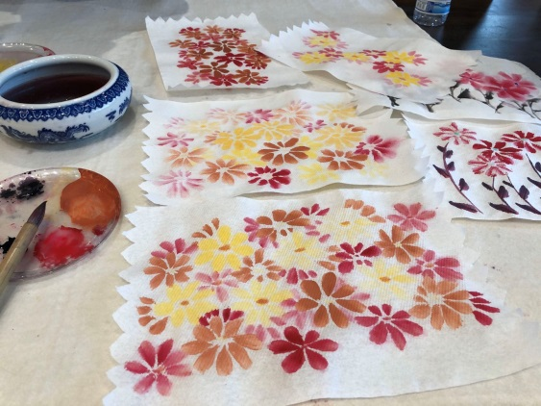

2020 Fall Online Chinese Culture Program
Enrichment Cultural Program Schedule
Monday 3:30- 4:30 PM Chinese Music
Tuesday 3:30-4:30 PM Calligraphy and Painting
Wednesday 3:30-4:30 PM Chinese History and Art
Thursday 3:30-4:30 PM Art of Chinese Papercutting
Friday 3:30-4:30 PM Chinese Chess

